Slide 1

Optimization Algorithms
Gradient descent with momentum
deeplearning.ai

Slide 2
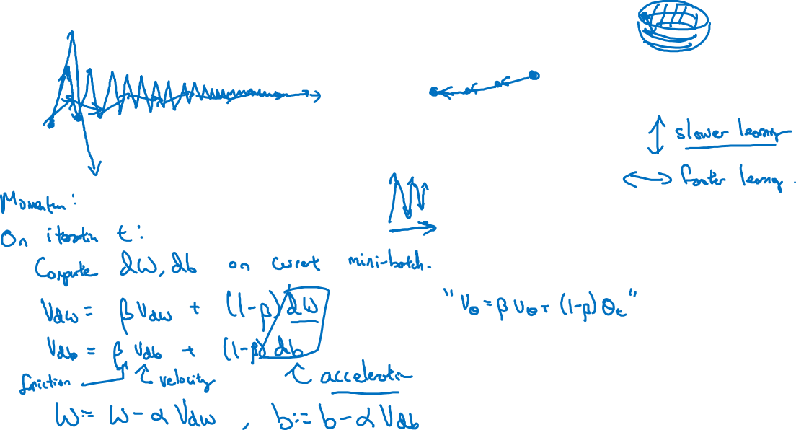
Gradient descent example
deeplearning.ai

Slide 3




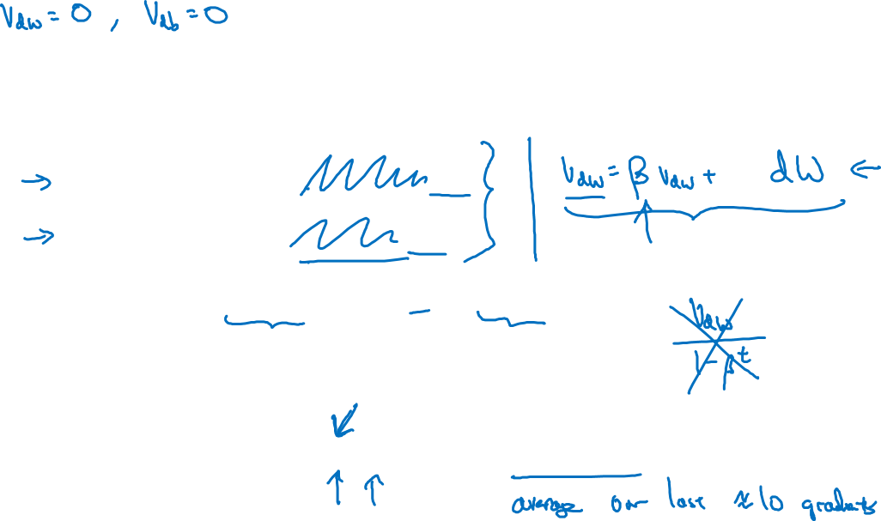
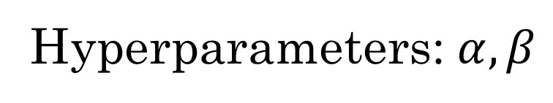


Implementation details
$$On iteration t:$$
Compute $dW,db$on the current mini-batch
$$v_{dW}=βv_{dW}+\left(1−β\right)dW$$
$$v_{db}=βv_{db}+\left(1−β\right)db$$
$$W=W−αv_{dW},$$
$$b=b−αv_{db}$$
Hyperparameters: $α,β$
$$β=0.9$$

